Slide 1

Credit Card Weekly Reports
- Pratyush Majumdar

Slide 2
Table of Contents
01
Objective
02
Data from MySQL
03
DAX Queries
04
Dashboard and Insights
1

Slide 3
Objective
The objective of this project is to develop a comprehensive weekly dashboard for credit card metrics that provides key insights to stakeholders, enabling them to make informed decisions.
This dashboard will serve as a vital tool for enhancing the performance, risk management, and customer experience of the credit card business.
2

Slide 4


Import data to MySQL
Prepare CSV files
Create database and tables in MySQL
Load the data into MySQL
3

Slide 5
DAX Queries
AgeGroup = AgeGroup = SWITCH(
TRUE(),
'ccdb cust_detail'[Customer_Age]<=30, "20-30",
'ccdb cust_detail'[Customer_Age]>30 && 'ccdb cust_detail'[Customer_Age]<=40, "30-40",
'ccdb cust_detail'[Customer_Age]>40 && 'ccdb cust_detail'[Customer_Age]<=50, "40-50",
'ccdb cust_detail'[Customer_Age]>50 && 'ccdb cust_detail'[Customer_Age]<=60, "50-60",
'ccdb cust_detail'[Customer_Age]>60 && 'ccdb cust_detail'[Customer_Age]<=70, "60-70",
'ccdb cust_detail'[Customer_Age]>70 && 'ccdb cust_detail'[Customer_Age]<=80, "70-80",
"Unknown")
IncomeGroup = SWITCH(
TRUE(),
'ccdb cust_detail'[Income]<=40000, "Low",
'ccdb cust_detail'[Income]>40000 && 'ccdb cust_detail'[Income]<=80000, "Med",
'ccdb cust_detail'[Income]>80000, "High",
"Unknown")
Week_Num_Sorted = WEEKNUM('ccdb cc_detail'[Week_Start_Date])
Revenue = 'ccdb cc_detail'[Annual_Fees] + 'ccdb cc_detail'[Total_Trans_Amt] + 'ccdb cc_detail'[Interest_Earned]
4

Slide 6
Previous_Week_Revenue = CALCULATE(
SUM([Revenue]),
FILTER(
ALL('ccdb cc_detail'),
'ccdb cc_detail'[Week_Num_Sorted] = MAX('ccdb cc_detail'[Week_Num_Sorted])-1))
Current_Week_Revenue = CALCULATE(
SUM([Revenue]),
FILTER(
ALL('ccdb cc_detail'),
'ccdb cc_detail'[Week_Num_Sorted] = MAX('ccdb cc_detail'[Week_Num_Sorted])))
WOW_Revenue_Change(%) = DIVIDE(([Current_Week_Revenue] - [Previous_Week_Revenue]), [Previous_Week_Revenue])
Previous_Week_Transaction_Amount = CALCULATE(
SUM('ccdb cc_detail'[Total_Trans_Amt]),
FILTER(
ALL('ccdb cc_detail'),
'ccdb cc_detail'[Week_Num_Sorted] = MAX('ccdb cc_detail'[Week_Num_Sorted])-1))
Current_Week_Transaction_Amount = CALCULATE(
SUM('ccdb cc_detail'[Total_Trans_Amt]),
FILTER(
ALL('ccdb cc_detail'),
'ccdb cc_detail'[Week_Num_Sorted] = MAX('ccdb cc_detail'[Week_Num_Sorted])))
WOW_Transaction_Amount_Change(%) = DIVIDE(([Current_Week_Transaction_Amount] - [Previous_Week_Transaction_Amount]), [Previous_Week_Transaction_Amount])
5

Slide 7

Previous_Week_Interest_Earned = CALCULATE(
SUM('ccdb cc_detail'[Interest_Earned]),
FILTER(
ALL('ccdb cc_detail'),
'ccdb cc_detail'[Week_Num_Sorted] = MAX('ccdb cc_detail'[Week_Num_Sorted])-1))
Current_Week_Interest_Earned = CALCULATE(
SUM('ccdb cc_detail'[Interest_Earned]),
FILTER(
ALL('ccdb cc_detail'),
'ccdb cc_detail'[Week_Num_Sorted] = MAX('ccdb cc_detail'[Week_Num_Sorted])))
WOW_Interest_Earned_Change(%) = DIVIDE(([Current_Week_Interest_Earned] - [Previous_Week_Interest_Earned]), [Previous_Week_Interest_Earned])
6

Slide 8
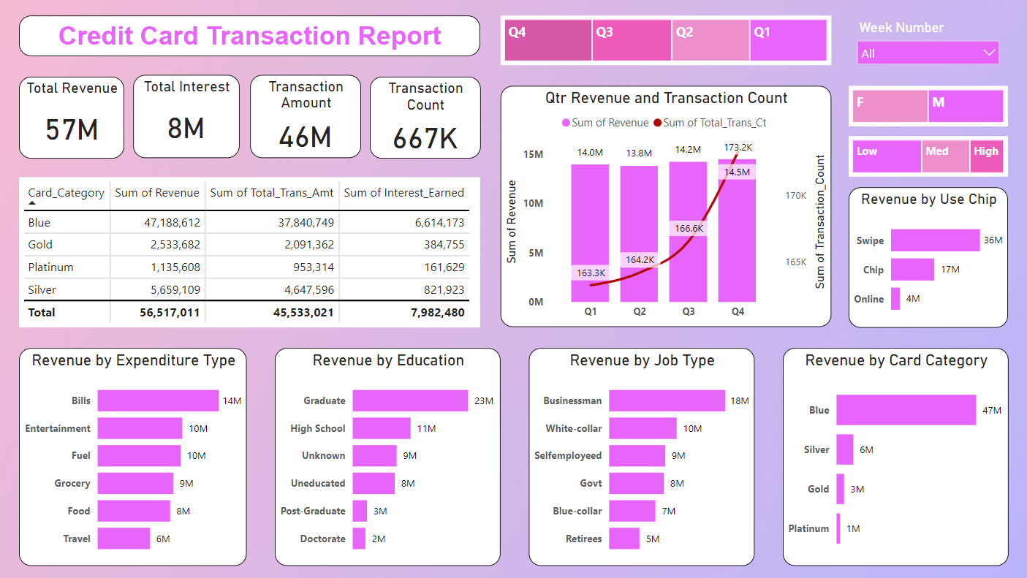
Dashboard & Insights
Credit Card Transacation Dashboard
7

Slide 9
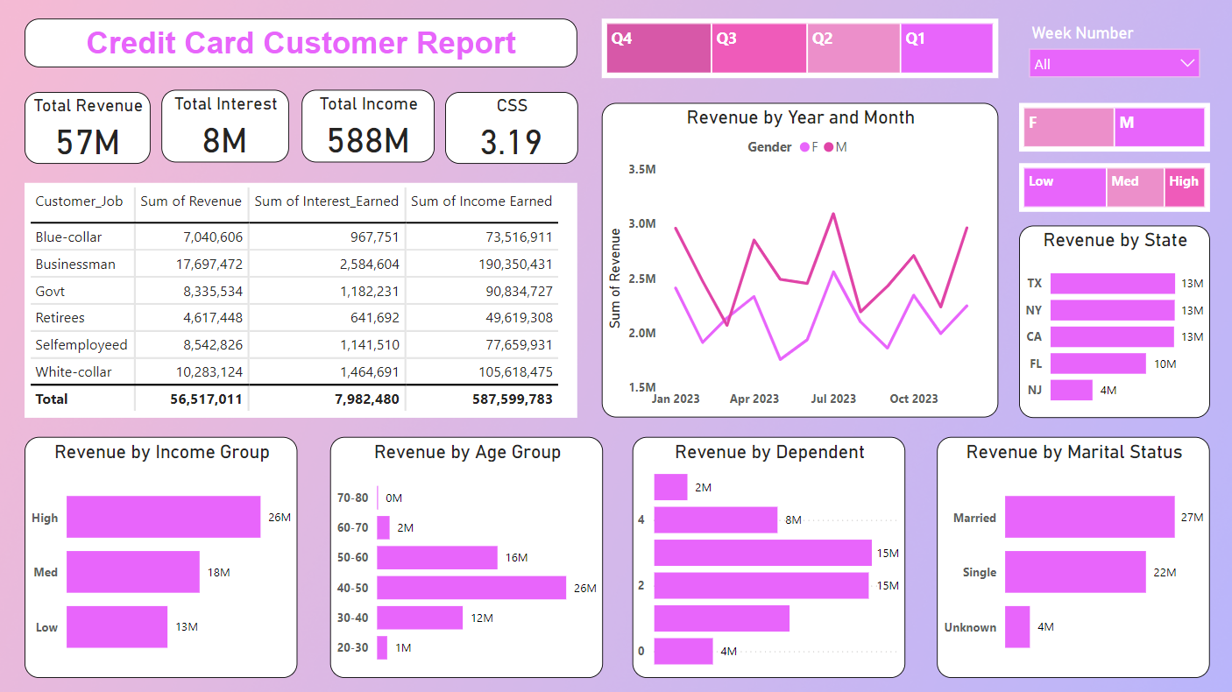
Credit Card Customer Dashboard
8

Slide 10
WoW Change:
Revenue Increased by 28.8%.
Transaction Amount Increased by 35%.
Interest Increased by 1%.
Overall:
Revenue Generated is 57M.
Interest Earned is 8M.
Transaction Amount is 46M.
Transaction Count is 667K.
Income is 588M.
9

Slide 11
Other Insights:
Average CSS is 3.19.
Delinquent rate is 6.06%.
Activation rate is 57.46%.
House Owner rate is 46.62%.
Car owner rate is 40.2%.
Personal Loan rate is 12.73%.
Male customers are contributing more in revenue [31M] than female customers [26M].
Highest Revenue is earned in Quarter-4 [14.5M].
Highest Revenue is generated from Texas, New York and California.
10

Slide 12

Thank You!
Dashboard Link: Credit Card Weekly Analysis

